Slide 1
How blended learning can assist you to multi-level your classes
WATESOL - 19th May, 2022
Facilitator Breda Matthews
Email: admin@englishlanguageresourcecentre.com
Website: https://www.englishlanguageresourcecentre.com/

Slide 2
What might a multi-levelled class look like?
More differentiation
More scaffolding
More group work
More independent work

Slide 3
Tasks must provide:
purposeful learning opportunities for all learners
multiple opportunities for learning
repetition and reinforcement of learning

Slide 4
There ARE limits.

Slide 5
You could
get a teacher aide
buy an online programme(s)
create your own multi-level programme but be realistic about what you can achieve in the available time

Slide 6
Plan your programme to allow time to work with small groups and individuals.
Ensure that:
units of work contains individualised materials that meet student needs
parts of your programme allow for independent work and use that time to work with small groups and individuals

Slide 7
Independent work needs to be
individualised
linked to current learning
allow students to work independently
have measurable outcome
easy to manage

Slide 8
Decide on the parts of your programme.
What can be done independently?
Do you want to create your own or buy a programme?
How will your students know what to do?

Slide 9
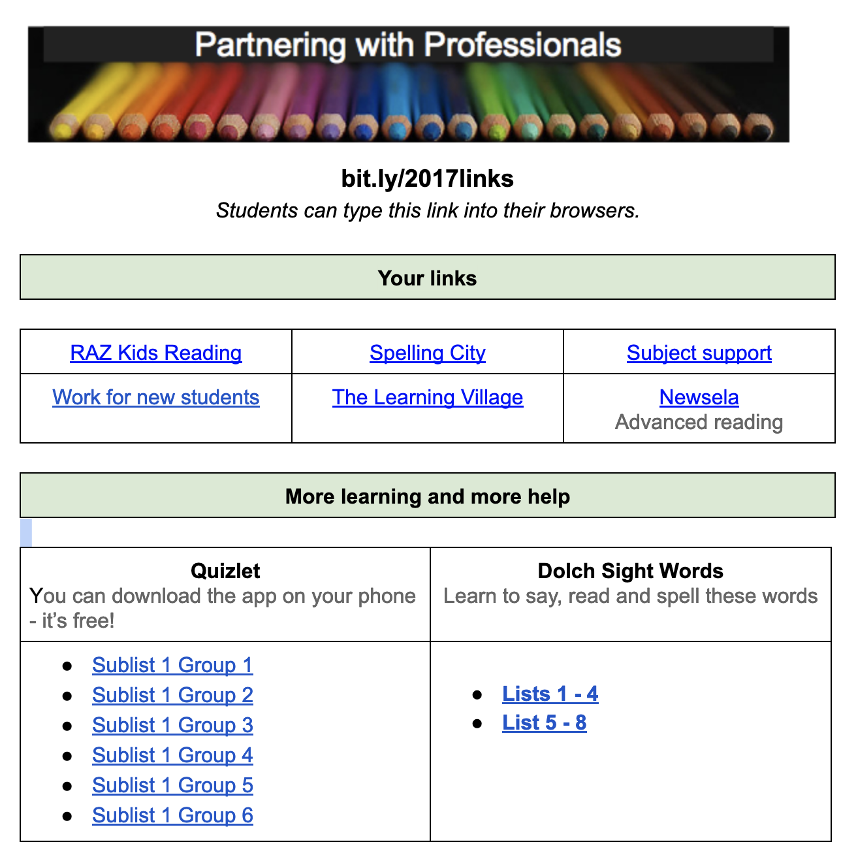

Slide 10
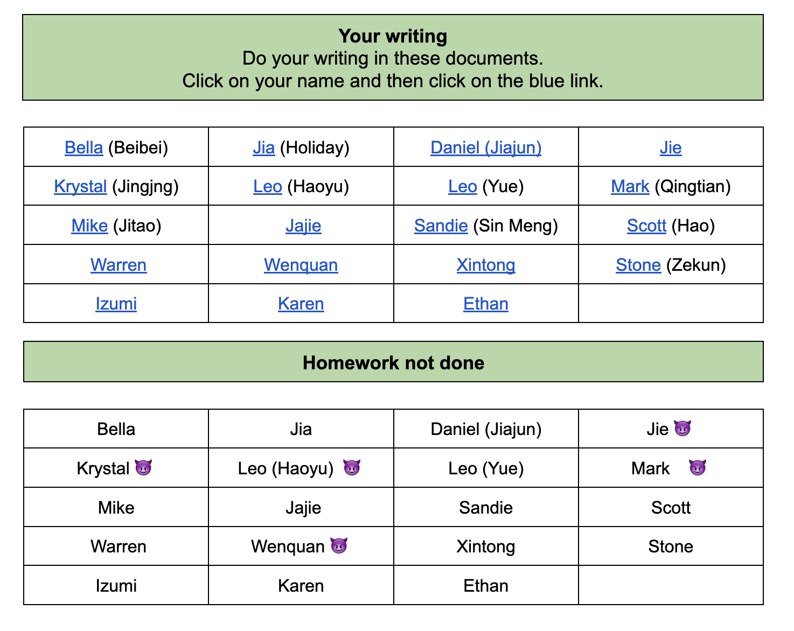

Slide 11
Vocabulary
What vocabulary learning can be done independently?
Do you want to create your own programme or buy a programme?
Do you want paper based or online?

Slide 12
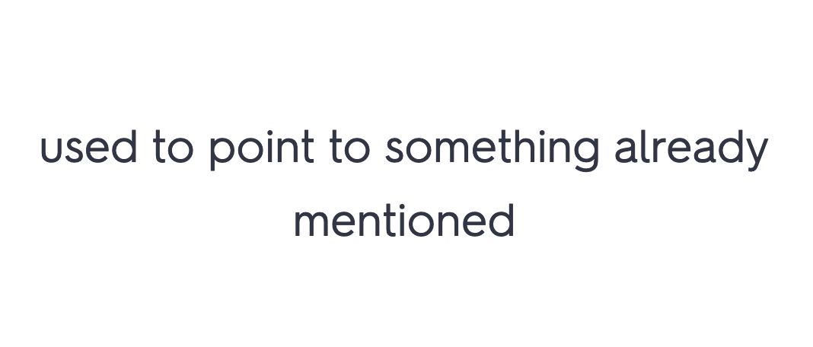
Vocabulary
Do your learners need text based definitions?

Slide 13
or image based?

Slide 14
Do you want paper based or online?
Paper based
Dee Publications
ESOL Online
Online resources
Quizlet access to ready made cards
Memrise access to ready made cards
Spelling City
Learning Village
Vocabulary tests / NAWL test - can be printed out
How will you manage marking?
Do your students have devices and internet access in class and at home?

Slide 15
Reading
What reading can be done independently?
Do you want to create your own or buy a programme?
Do you want paper based or online?

Slide 16
Tools to support learning and reduce your workload
Hard copy resources
Graded readers + reading logs
Front Foot English
Instructional series - Literacy Online
Pasifika Dual Language Resources
Online programmes
Read Works
Read Theory
Newsela
RAZ Kids Reading and Learning A-Z
The Learning Village
How will you manage marking?
Find more online programmes here
Do your students have devices and internet access in class and at home?

Slide 17
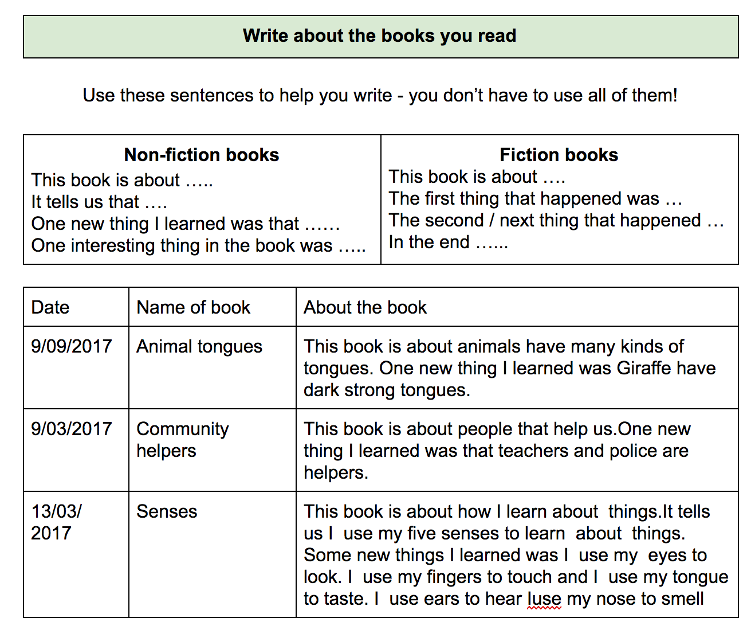
Reading logs

Slide 18
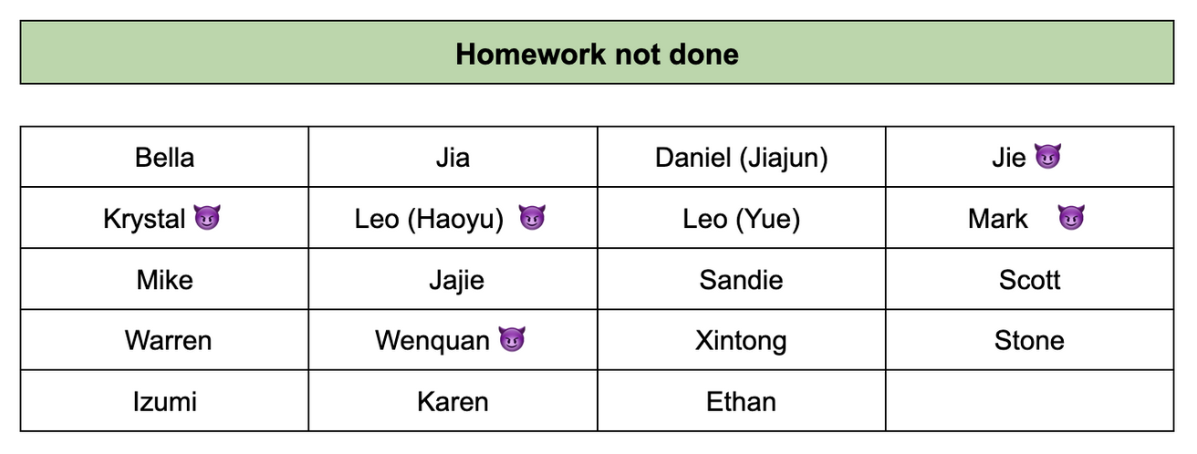

Slide 19
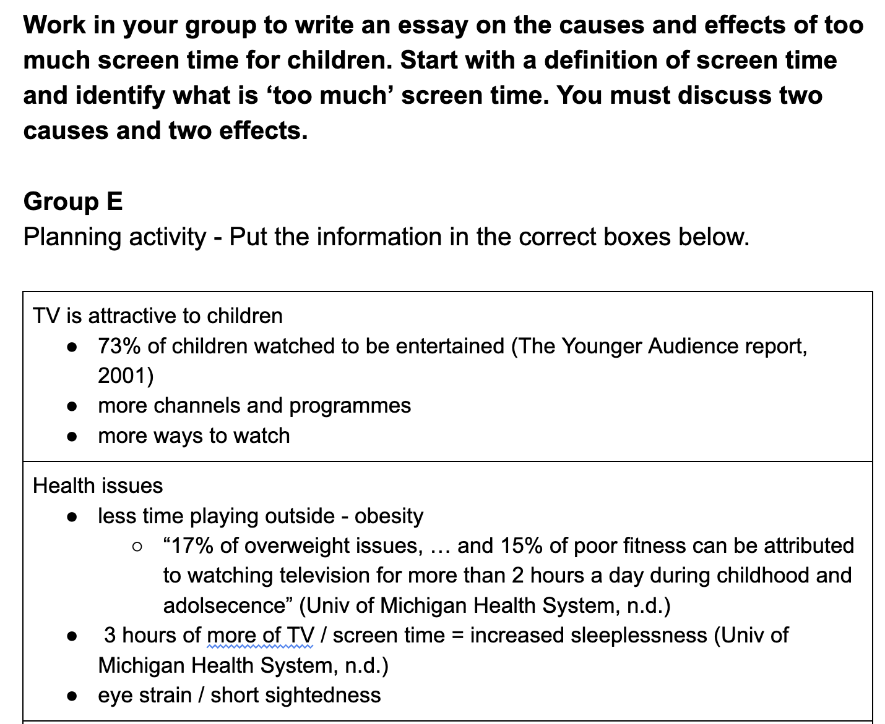
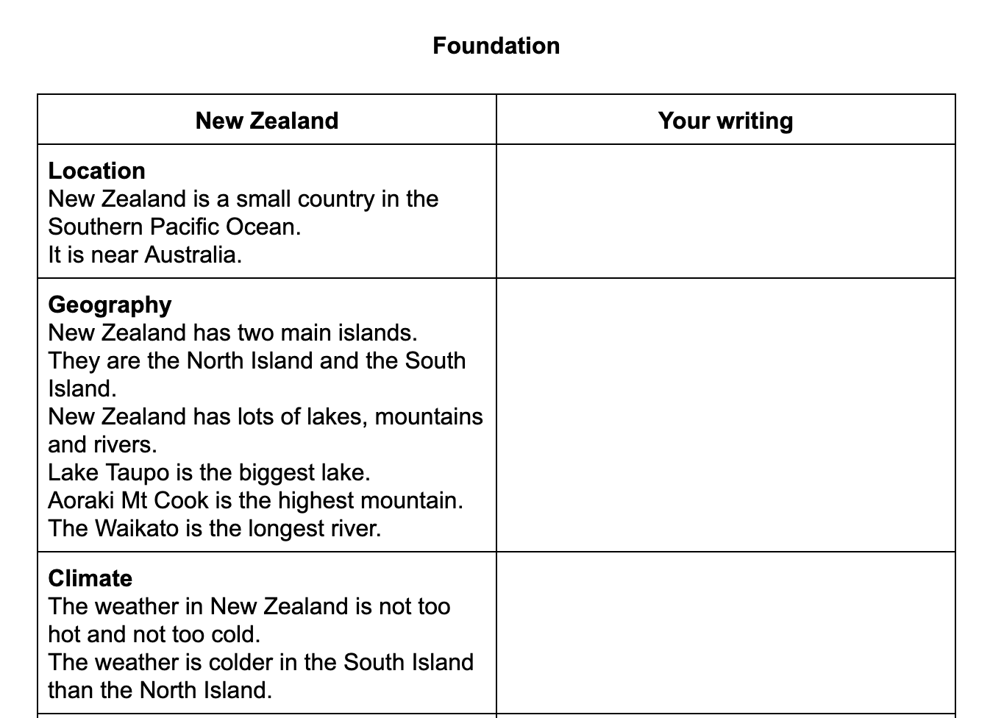
Task should relate to the in class learning outcomes and not be busy work.
Scaffold writing tasks and use group work - see this example for more advanced learners
Provide sufficient input and differentiate outcomes - Example 1- scaffolded output
Example 2 - differentiated tasks
parallel writing differentiated

Slide 20
Not everything needs to be assessed summatively.
Avoid over assessment.
Presentations can be assessed from Level 1 Foundation to Level 4 EAP.
Presentations can be linked to formative listening tasks.

Slide 21
Choose topics than can be multi-levelled and
can be used with the range of students in your classes.
Some topics are easier to level up and down than others.
Climate change
Disasters
Descriptions of people
Globalisation

Slide 22
Choose topics that will provide opportunities for teaching as well as assessment across a range of skills
Does this topic provide enough opportunities for students to
read and listen to texts on these topics?
speak and write about these topics?
Is the topic wide enough to provide for both formative assessment and summative assessment thereby easing the learning burden for students

Slide 23
Integrate your topic - Introductions
Speaking and Listening
Students interview each other
Reading
Students read descriptions of people and biographies
Writing
Students use their interviews to complete forms and write descriptions and / or biographies

Slide 24
Assessment opportunities might include
Speaking
Presentations
Interviews
Listening
Listen to spoken information
Reading
Wide reading
Close reading
Writing
Fill in forms
Descriptions

Slide 25
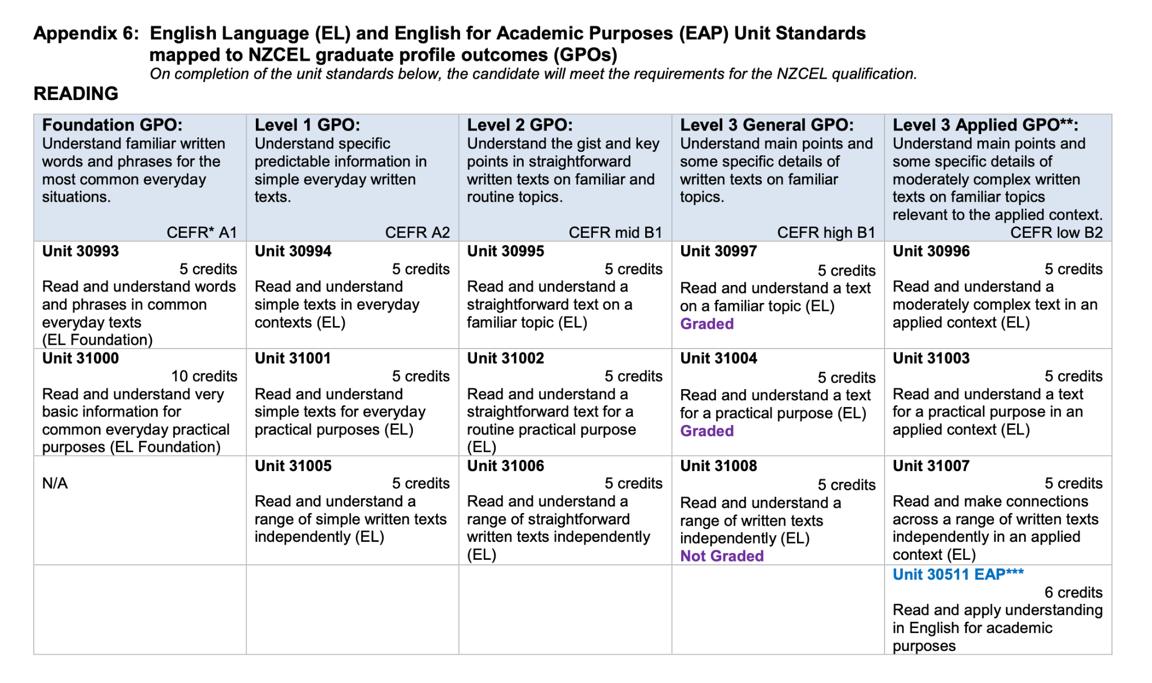
What are the teaching and assessment opportunities?
Download the NZCEL Guiding Document

Slide 26
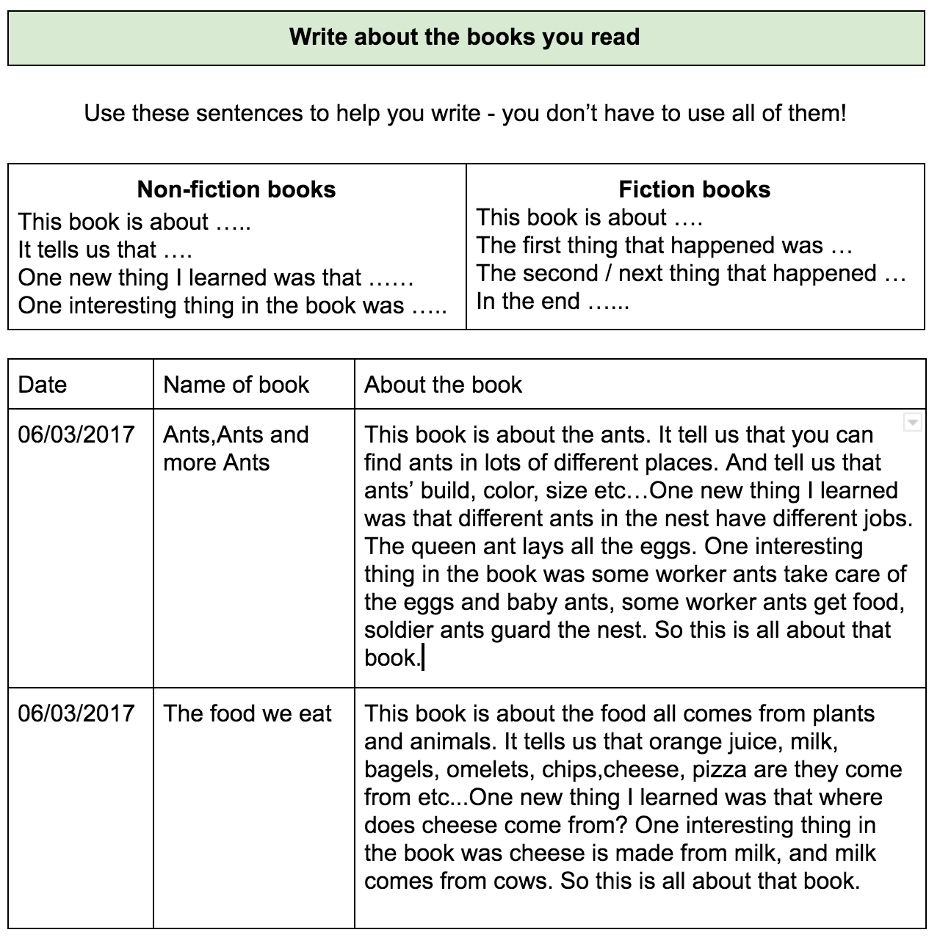
You can use independent work for assessment.
If you need to verify authenticity, use a short student conference or even turn this into an interview

Slide 27
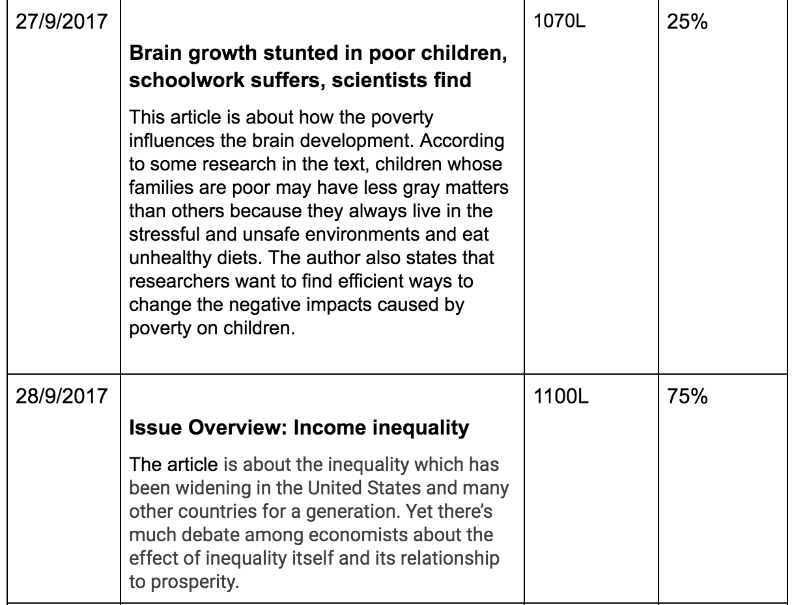

Slide 28
What Ministry resources are available on for new learners?
ESOL Online has units of work there are also some materials in the Teacher's Resource Exchange. In addition there are ELIP resource units including Focus on English, Bamboo and Flax, and Microbes.

Slide 29
Questions?
Access this PPT at
https://bit.ly/WATESOL2022

