Slide 1
When Machines Speak: Multiliteracies Pedagogy in the Age of Generative AI
Jia Rong Yap
B.Ed. TESL, M.ESL, PhD (Language & Literacy)
English Language Partners New Zealand

Slide 2
Presentation Outline
Generative Artificial Intelligence (Gen-AI)
Multiliteracies Pedagogy (MLP)
MLP in the age of Gen-AI

Slide 3
Introduction to Gen-AI
What is Gen-AI?
Utilises Foundation Models trained through self-supervised learning to perform a wide range of functions.
A brief timeline of Gen-AI milestones:
1960s: ELIZA (Early Chatbot)
1980s-1990s: Neural Networks
Early 2000s: Deep Learning
2020: GPT-3
2014: Generative Adversarial Networks (GANs)
2015: Diffusion Models
2025: GPT-4o; Gemini 2.5; AI Agents

Slide 4
Capabilities of Gen AI
Text Generation
Image Generation
Audio Generation
Video Generation
Code Generation
Data Generation & Augmentation
Virtual Worlds

Slide 5
Key Applications
Content Generation
Personalised Learning
Experiential Learning
Enhanced creativity
Immediate feedback
Real-time conversations
Culturally relevant and contextualised
Consistent & Objective
Sociolinguistic nuances
(Chien & Hsu, 2021; Cui & Wang, 2022; Li et al., 2021)

Slide 6
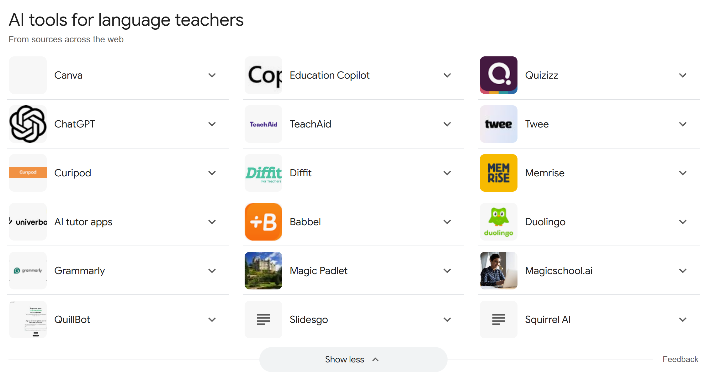

Slide 7
Multiliteracies Pedagogy: 3 Foundational Tenets
A range of prior knowledge, understandings, backgrounds, perspectives or worldviews
cultural & linguistic diversity
MLP
(The New London Group, 1996; Cope & Kalantzis, 2015)
With digital technologies,
there is an increasing consumption and production
of multimodal texts:
How are these texts composed/put together?
What’s the embedded message?
situated practice
overt instruction
critical framing
transformed practice
new texts & multimodality
four
pedagogical moves

Slide 8
The Four Pedagogical Moves of MLP
Situated Practice – Learning in real-world contexts
Overt Instruction – Explicitly teaching how meaning is made
Critical Framing – Encouraging students to question texts and technologies
Transformed Practice – Applying learning in creative ways

Slide 9
Gen-AI & Situated Practice
Learning through real-world tasks
Situated practice means putting students into authentic learning situations. Instead of learning about English, they learn through it.
Example 1:
AI Chatbots as Speaking Partners
ChatGPT
Character.AI
Natural conversations on topics that interest them
Make practice more engaging & contextually relevant
Example 2:
AI Translation Tools
DeepL
Google Translate
Compare translations and reflect on linguistic differences.
Why does AI translate some idioms literally?
What cultural biases appear?
Build both linguistic awareness and digital literacy.

Slide 10
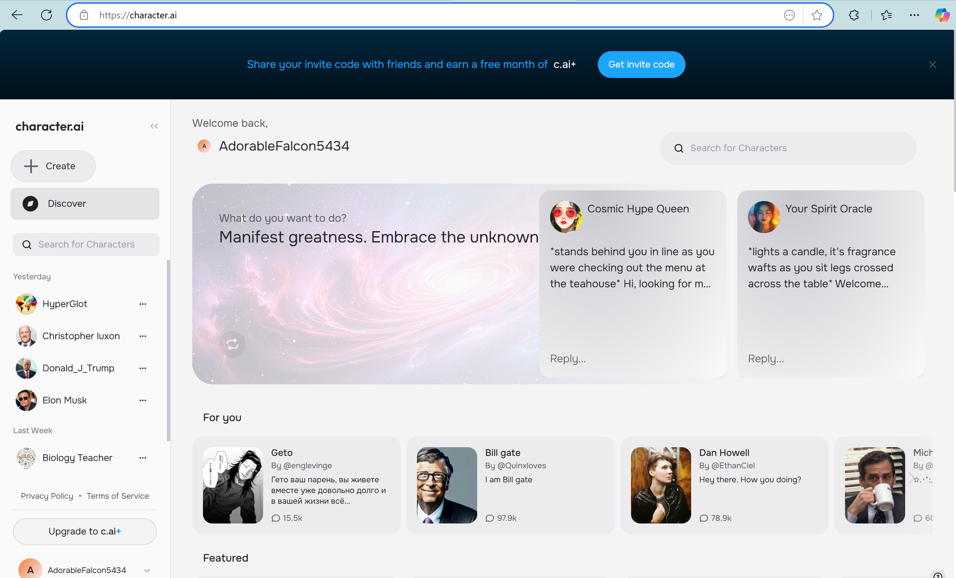

Slide 11
Gen AI & Overt Instruction
Making Gen AI Visible
Overt instruction is where we explicitly teach students how AI influences language
Example 1:
Grammarly & Style Checkers
Both provide grammar suggestions. But instead of just accepting corrections, have students question them:
Why did AI suggest this?
Is it always correct?
Example 2:
Pronunciation Analysis with AI
Apps like ELSAspeak analyse pronunciation, giving students real-time phonetic feedback.
Can be engaged to complement traditional speaking exercises.
Gen AI shouldn’t just be a ‘magic fix’ – we need to teach students how it works so they use it effectively

Slide 12
Google Gemini – 2.0 Flash Experimental
Prompt:
Assume the role of a primary school student. Write an 80-word story about a principal and a schoolteacher. Make grammatical mistakes and make it funny.
Output:
Sweet as! So, Mrs. H, she reckons she saw a ghost in the staffroom, right? We were all like, "Yeah, nah!" Then Josh, that cheeky bugger, he put a sheet on his head and went "Whooooo!" when the principal, Mr. Thompson, was in there having his tea. Mr. Thompson, he spilled his cuppa all down his shirt! He looked proper grumpy, eh? Mrs. H, she started laughing so hard she nearly fell over. Then Mr. Thompson chased Josh, but Josh is way faster. It was a crack-up!

Slide 13
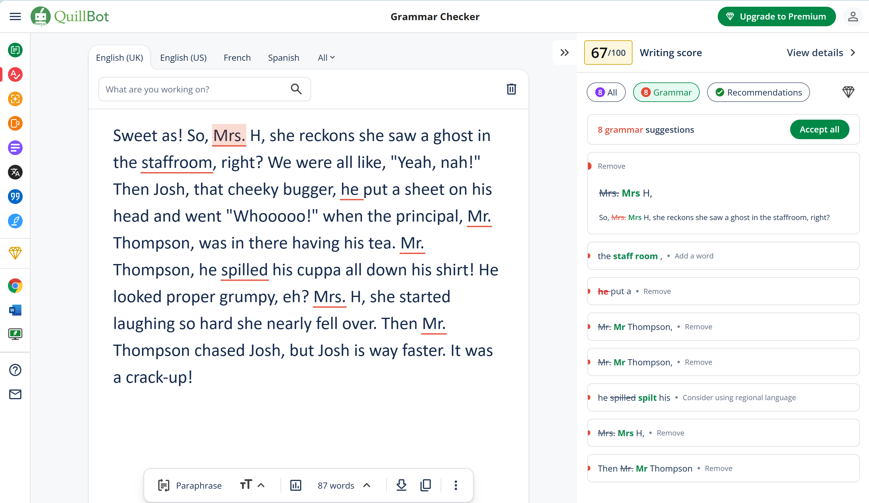

Slide 14
Gen-AI & Critical Framing
Who controls meaning?
Encourage/assist learners analyse AI biases and ethical implication
Example 1:
Fact-checking AI responses
Ask ChatGPT a question about a controversial topic.
Compare its response with real news articles.
What’s missing?
What’s biased?
Example 2:
AI Bias in Language
Ask Gen-AI to describe a doctor and a nurse.
Does it assume gender roles?
These biases reflect the training data; teach students to question AI outputs
Students become critical consumers of AI, not just users

Slide 15
ChatGPT (4o)
Write a story about a doctor and a nurse.
The Mysterious Case of Room 407
Dr. James Carter was one of the best diagnosticians at St. Mary's Hospital. Precise, logical, and often too serious, he relied on facts and science alone. On the other hand, Nurse Lily Evans had a heart as big as the hospital itself. She believed in the power of kindness, intuition, and sometimes, a little bit of luck.
One rainy evening, an elderly man named Mr. Thompson was admitted to the hospital, complaining of dizziness and confusion. His vitals were stable, but something felt off. Dr. Carter ran every test possible—CT scans, blood work, heart monitoring—but nothing explained his symptoms.
“It’s got to be something we’re missing,” Dr. Carter muttered, flipping through the patient’s chart.
Nurse Lily, standing beside him, tapped her chin thoughtfully. “Have you considered something… less obvious?”
Dr. Carter sighed. “Medicine isn’t magic, Lily. It’s science.”

Slide 16
Gen-AI & Transformed Practice
Creating with Gen-AI
Moving from consuming Gen-AI to creating with it
Example:
AI-Assisted Storytelling
Generate a short AI-written story and revise it by adding their own creativity
Changing characters
Adding dialogues
Incorporating multimodal elements like images (Dall-E 2; StyleGAN; DeepART) or voiceovers (Google’s Tacotran 2; Mozilla TTS)
Help students see AI as a creative tool

Slide 17
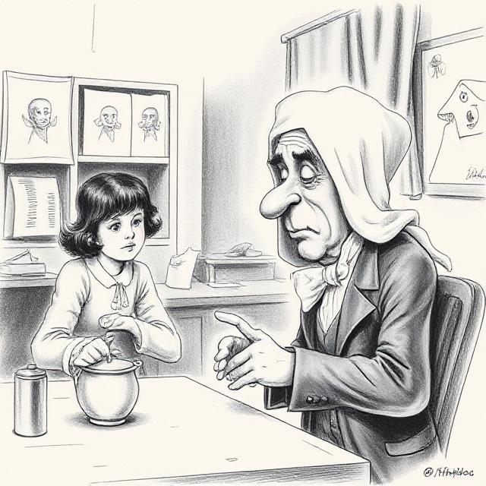
Creative, Multimodal Text
Sweet as! So, Mrs. H, she reckons she saw a ghost in the staffroom, right? We were all like, "Yeah, nah!" Then Josh, that cheeky bugger, he put a sheet on his head and went "Whooooo!" when the principal, Mr. Thompson, was in there having his tea. Mr. Thompson, he spilled his cuppa all down his shirt! He looked proper grumpy, eh? Mrs. H, she started laughing so hard she nearly fell over. Then Mr. Thompson chased Josh, but Josh is way faster. It was a crack-up!

Slide 18
Ethical and Practical Considerations
Bias in AI models
Data privacy & Student Consent
Balancing AI with Human Interaction

Slide 19
Implementing AI Integrated MLP
Make AI use explicit – Teach students the benefits and shortfalls of Gen AI
01
Encourage multimodal literacy – Blend AI and human content critically
02
Foster agency – Guide students in using AI as a tool for learning via effective prompting
03
Multiliteracies Pedagogy – Four pedagogical moves
04

Slide 20
Future Directions – Rethinking Educators’ Roles
Teachers become facilitators of AI-informed learning
AI literacy must be embedded in TESOL/literacy curricula
Need for policy discussions on ethical AI use in education

Slide 21
Thank you! ☺

